Slide 1
Final Presentation
Large Scale Web Crawling and Distributed Search Engines: Techniques, Challenges, Current Trends, and Future Prospects
Group No. 12
Asadullah Al Galib - 21266015
Md Humaion Kabir Mehedi - RA
Ehsanur Rahman Rhythm - ST

Slide 2
Introduction
Google: Centralized search engine. PageRank algorithm, distributed web crawler.
Billions of websites on the internet.
Enormous variety in site structure, content type.
Regular or surface web VS deep web crawling.
Current status of distributed search engines and challenges.
Implications of large language model based conversational AI agent.
Domain-agnostic asynchronous crawler. Single threaded.
Content structure:
Related works
Crawling
Distributed search engines
AI conversational agents
Domain-agnostic asynchronous crawler

Slide 3
Related Work
A systematic literature review of over 1488 articles on web crawling [4]
Board Forum Crawling, specifically designed for crawling forum sites efficiently [5]
A comprehensive study of deep web crawling techniques currently in use [3]
Challenges and learnings of a high-performance, distributed, scalable web crawler [6]
Distributed search engine based on cooperative model [7]
A hadoop based distributed search engine [8]
Comparison among crawlers in terms of applicability, usability, scalability [10]

Slide 4
Crawling
Components of a basic web crawler:
Seed URL list
Aggregator: Collects web pages
Parser: Parses web page content. Add new target URLs
Types of crawlers:
Universal or board crawler
Topical crawler
Forum crawler
Deep or hidden web crawler
Techniques
Centralized VS distributed crawling
Hybrid crawling
Distributed crawling architectures
Common Crawl
Challenges and prospects

Slide 5
Distributed Search Engine
No single node controlling different parts of the search engine.
Must be efficient, scalable, and cost-effective.
Peer-to-peer system, Gnutella.
Overlay of server nodes for local indexing.
YaCy: Distributed, peer-to-peer search engine.
Apache Lucene
Elasticsearch
Challenges and prospects

Slide 6
AI Conversational Agents
ChatGPT
Large language models
Challenges to traditional search engines
Social and ethical impacts
Future prospects

Slide 7
Domain-Agnostic Asynchronous Crawler
Handle a multitude of sites with different content types and architectures.
Components:
Orchestrator
BaseCrawler
SiteHandler
Utility
Experiment: 2 sites, 200 pages
Sync: 382 minutes
Async: 79 minutes
Usage, Scopes, and Limitations

Slide 8
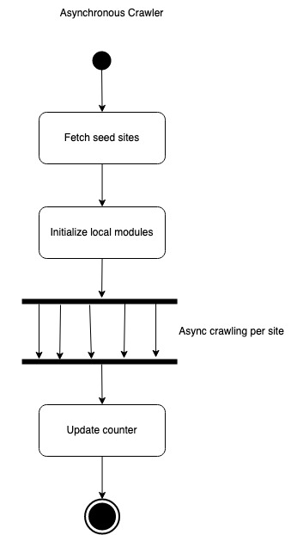

Slide 9
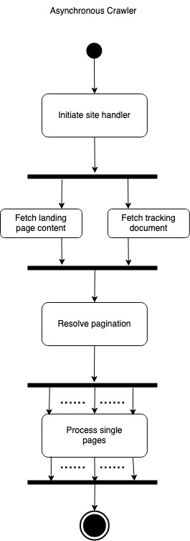

Slide 10
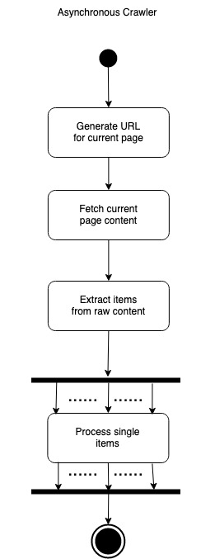

Slide 11
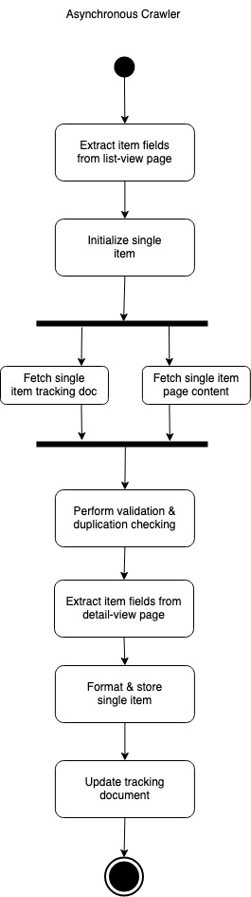

Slide 12
Conclusion
Techniques for large-scale crawling.
Distributed crawling architectures.
Challenges and future directions of large-scale crawling in the age of data.
Impact of large language models on traditional search engines.
Domain-agnostic asynchronous crawler.

Slide 13
Reference
Brin, S., \& Page, L. (1998). The anatomy of a large-scale hypertextual web search engine. Computer networks and ISDN systems, 30(1-7), 107-117.
Hernández, I., Rivero, C. R., \& Ruiz, D. (2019). Deep Web crawling: a survey. World Wide Web, 22, 1577-1610.
Kumar, M., Bhatia, R., \& Rattan, D. (2017). A survey of Web crawlers for information retrieval. Wiley Interdisciplinary Reviews: Data Mining and Knowledge Discovery, 7(6), e1218.
Najork, M., \& Heydon, A. (2002). High-performance web crawling (pp. 25-45). Springer US.
Ren, X., Wang, H., \& Dai, D. (2020, December). A Summary of Research on Web Data Acquisition Methods Based on Distributed Crawler. In 2020 IEEE 6th International Conference on Computer and Communications (ICCC) (pp. 1682-1688). IEEE.
………

